Slide 1
Building Bridges
Kristin Wiens and Bethany Wiens
@kwiens62
@BeBethanyBee
www.northstarpaths.com

Slide 2
Building Bridges
Between Student Support Services and Classroom Teachers
Between Research and Practice
Between Teachers

Slide 3
Today’s Road Map
Sensory Needs
Clear Communication
Visuals

Slide 4
UDL
Universal Design for Learning
What’s good for some can benefit all.

Slide 5
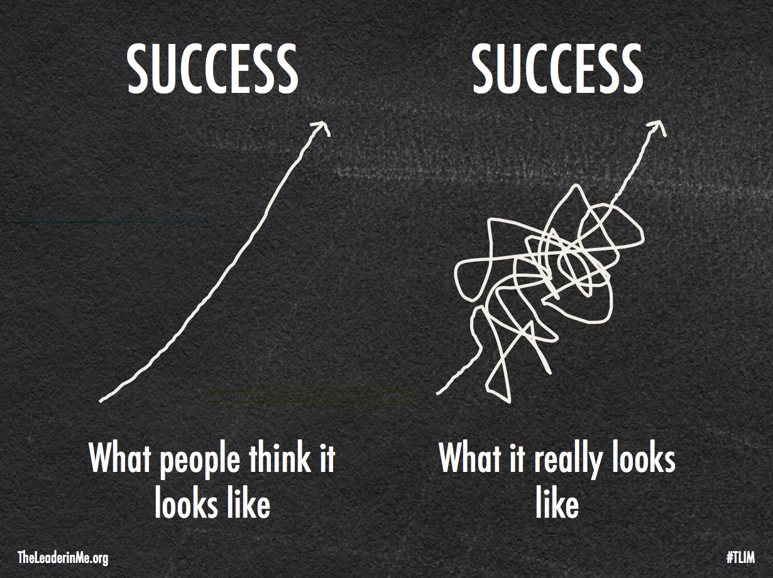
Growth Mindset

Slide 6
Movement Break: Just Like Me

Slide 7
Sensory Needs: Why is it important?
Sensory integration is how our senses work together to process and organize information we are receiving from our environment.
When we are able to process our environmental information well, we can use the information in meaningful ways

Slide 8
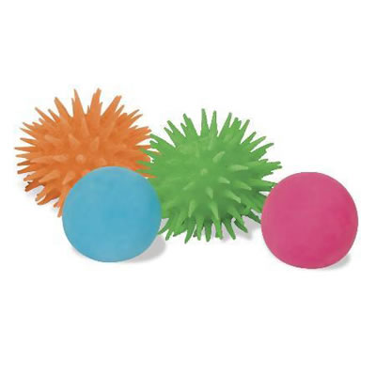
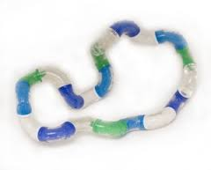
Sensory Tools
Fidgets
Velcro Strips
Thinking Putty
Yarn Sections
Juggling Balls
Pencil Grips
Stress Ball
https://www.youtube.com/watch?v=95w8OL0EYBU
Notes:
Sensory Needs: Sensory Tools

Slide 9
Tools Not Toys
Is it helping you learn?
Is it allowing others to learn?
If not, what else can we try?

Slide 10
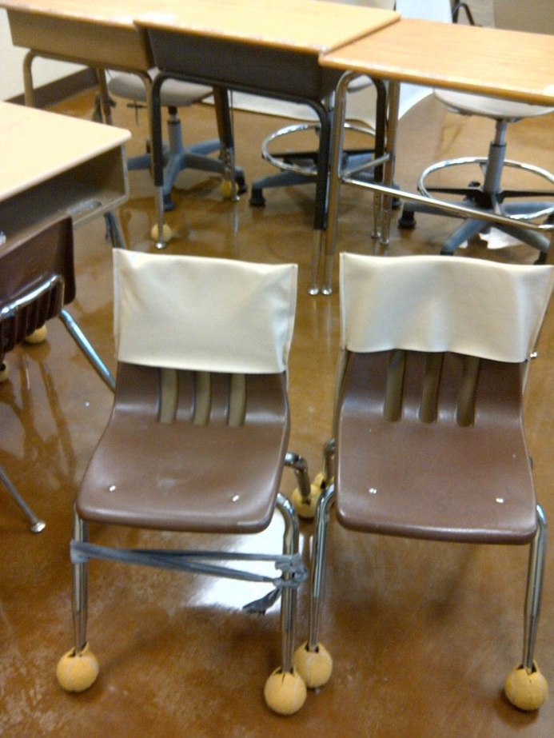
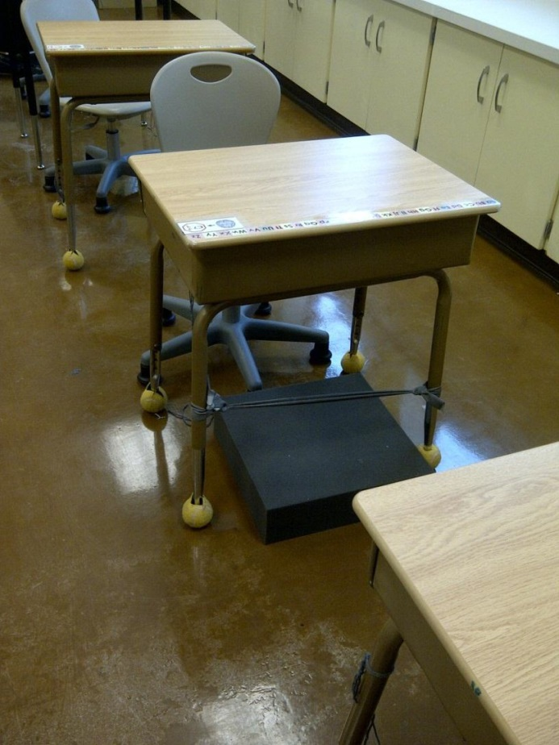
Seating Options

Slide 11
Sensory Needs: Movement

Slide 12
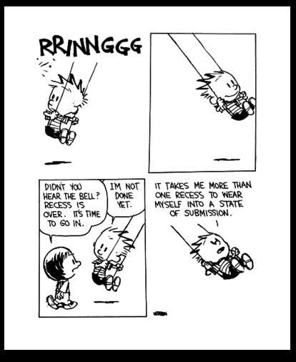

Slide 13
Please ask teachers to never take away a child’s recess. Please, please, please!
~Occupational Therapist, SD62

Slide 14
Sensory Needs: Movement Breaks
Why are they important?
Kids get stressed when they don’t move enough.
Movement and sensory experience is necessary to strengthen connections between neurons.
Promotes self-regulation.
Notes:
BW - Go Noodle

Slide 15
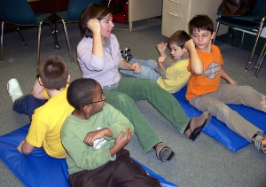
Occupational Therapists
yourtherapysource.com
Notes:
OT at your school is a great resource - if not this site is recommended - lots of other sites

Slide 16
Walk and Talk
Notes:
BW - Classmates, you and student, communication with teacher (how long)

Slide 17
GoNoodle
Notes:
BW - Go Noodle

Slide 18
Gentle Brain Breaks
Take 5
Tone Bar
Mindful Listening
Mindful Walking
Mindful Eating

Slide 19
Classroom Environments
Visual
Auditory
Physical

Slide 20
Less Busy Displays
Keep displays simple
Keep displays at the back of the classroom or hall
When materials are not use, put them out of sight
Focuses students’ attention on what is important
Notes:
BW - less busy more focus

Slide 21
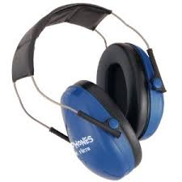
Headphones
Offer them to all students
Noise cancelling or headset with calming music
Notes:
BW - Westshore (plugged in, fake) headphones 1/2

Slide 22
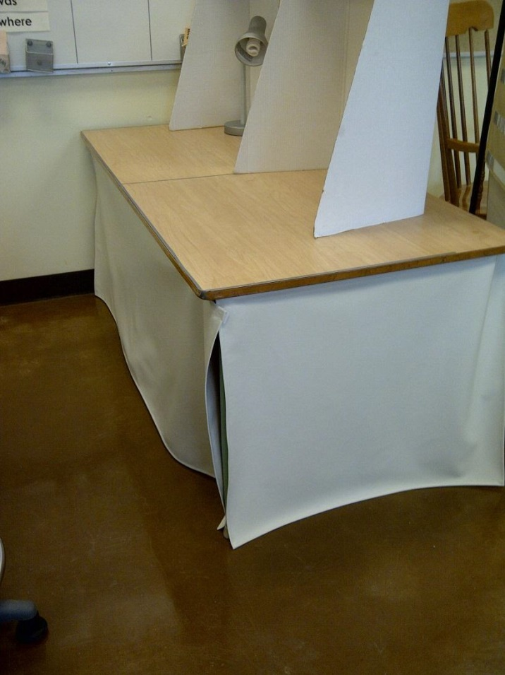
Spots to “hide away” but stay in the classroom
Notes:
BW - Silent reading-focus/escape/less bolting

Slide 23
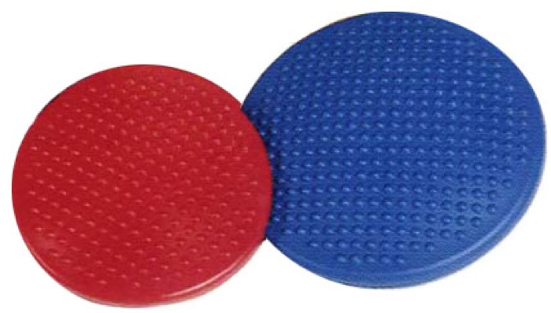
Wiggle Cushions/
Disc-o-Sits

Slide 24
Clear Communication
Why is it important?
School days are full of language
Anxiety inhibits communication and comprehension.
Notes:
All day we are making requests, presenting information, offering feedback and giving directions.
Many of our students arrive at school anxious. Anxiety inhibits effective communication and comprehension.

Slide 25
We think we understand…
http://www.youtube.com/watch?v=jcXEtKSRI8Y

Slide 26
Multiple Perspectives
I asked my son to help prepare supper. I asked him to peel half the potatoes in the bag and put them in the pot of water………

Slide 27
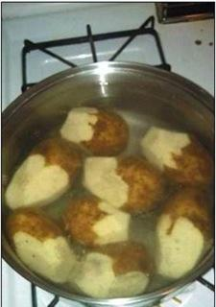
Was I not clear?

Slide 28
Last night I asked my husband to put some spaghetti on the stove so I could start dinner when I got home. I came home to this…

Slide 29
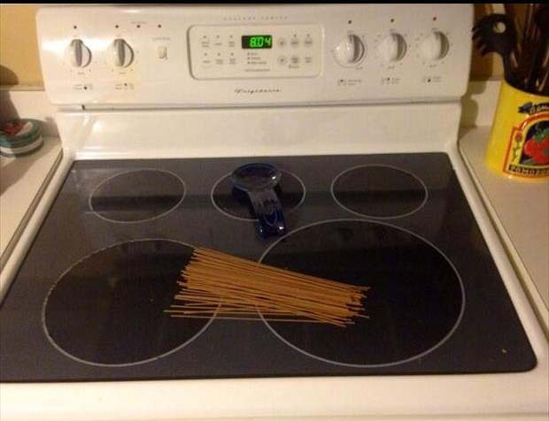

Slide 30
Process Time/ Wait Time
Children with language delay or disorders require extra time
Research show on average we give children 1-2 seconds to respond to directions
10-15 is recommended
Use visual supports

Slide 31
Process Time
Who was the first Prime Minister of Canada?

Slide 32
Processing/Wait Time: Story
Notes:
BW - Cale Westshore Trying all the right things - us and them

Slide 33
Language Production can be difficult too..

Slide 34
No “N” in this story…..
What are your plans for this weekend?

Slide 35
Chunk Information
Working memory holds a limited amount of information at one time and when working memory is full, the excess information will just drop out—as in disappear.

Slide 36
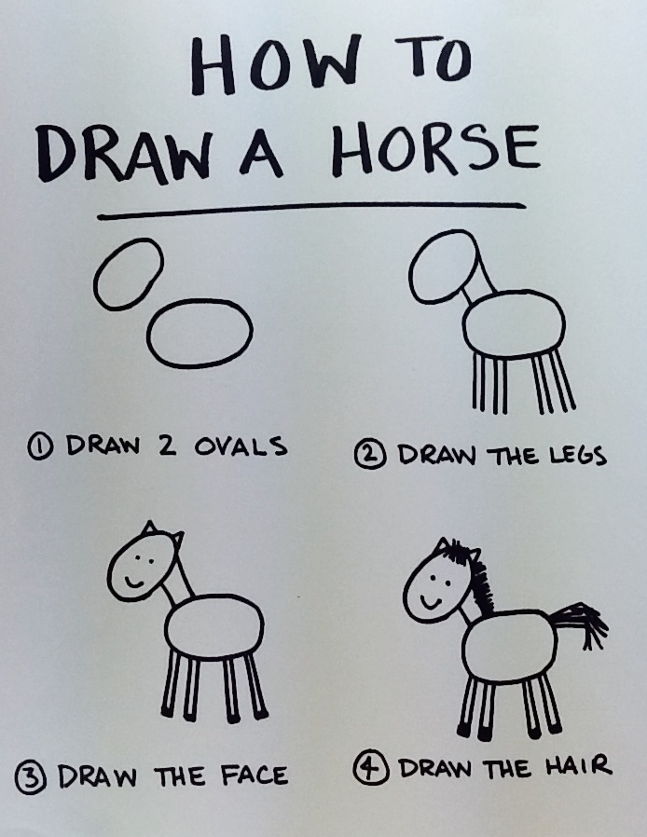

Slide 37
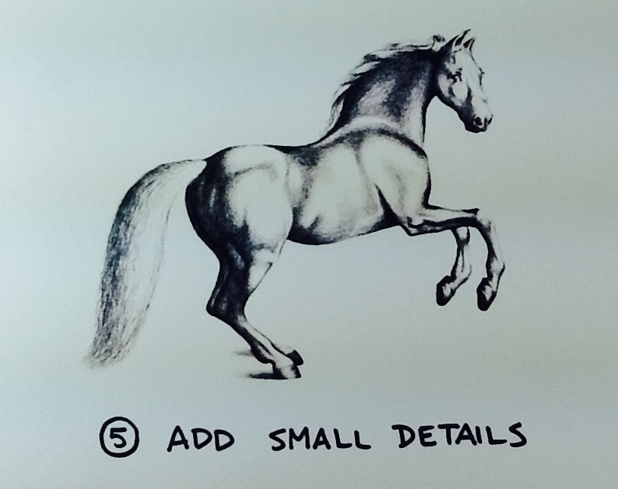

Slide 39
Visuals
https://www.youtube.com/watch?v=s1eZ7h6u3JM

Slide 40
Classroom Visual Schedules
Can help students know what to expect
Smoother Transitions
Lowers anxiety
Provides motivations to work through non-preferred activities

Slide 41
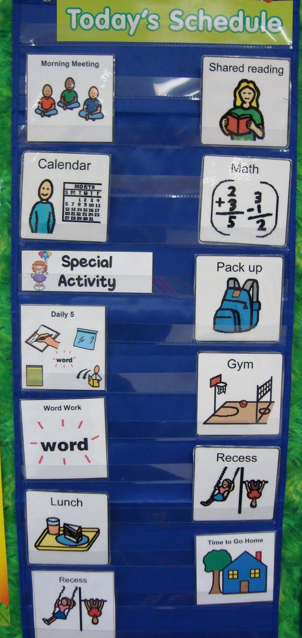
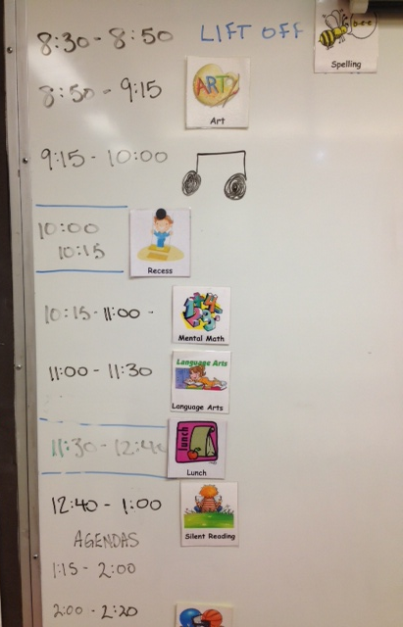

Slide 42
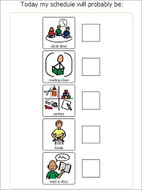
Remember:
Follow it! If not change it.
Make it part of the routine.
Continually refer to it.
Allow enough time to use it.
Use it with the whole class.
Notes:
Leeland story

Slide 43
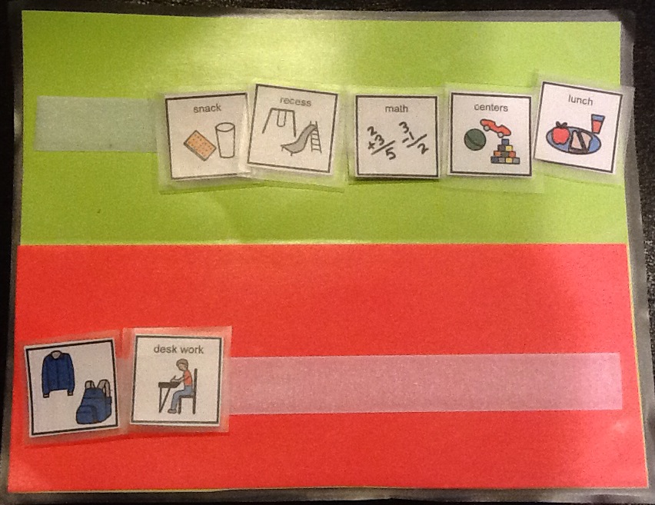
Individual Visual Schedule

Slide 44
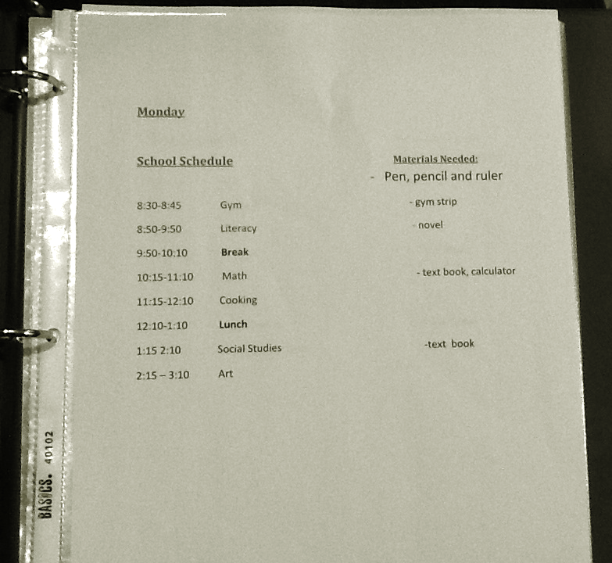

Slide 45
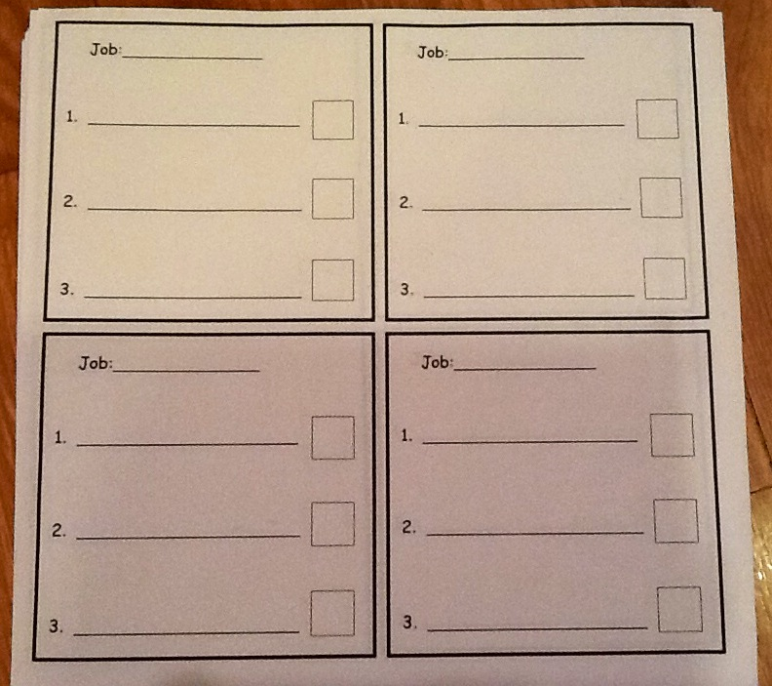

Slide 46
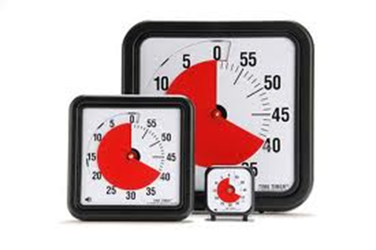
I have been teaching for 30 years and I have no idea how I have done it without a time timer.
Kindergarten Teacher, SD 62

Slide 47
Time Timers Can:
Provides permanent information
Smoother transitions
Builds independence
Best used as often as possible - not just when a student “needs” it
Notes:
BW - breaks (L exercise T games)

Slide 48
Visual Routines
Support learning a new skill
Breaks task into smaller parts
Helps with working memory
Builds independence

Slide 49
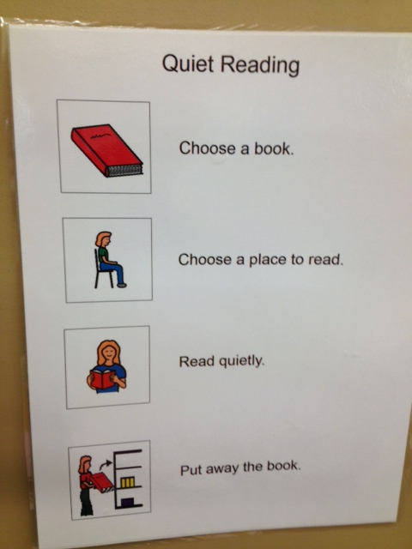

Slide 50
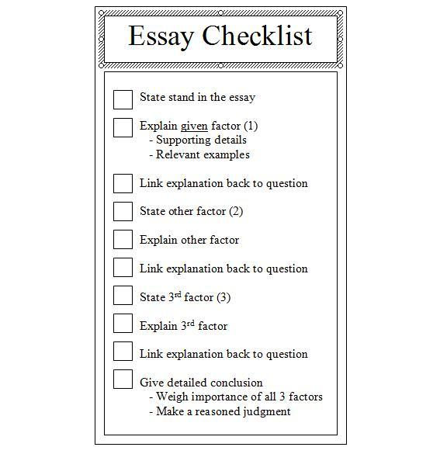

Slide 53
The Game of School

Slide 54
A professional once told me that I would not have gone past grade five or six in any subject.
I decided to go to Westshore and to graduate on the regular program even though it meant that I would have to perhaps struggle. I proved to myself that I can achieve anything by trying and not giving up.
A quote that represents my personal experience in my school career was from my middle school teacher, Ms. Kirsten Wiens. She said, “What he lacked in skills, he made up in determination and a willingness to work on the issues”.
I think this quote can apply to every student in some shape or form for the rest of our lives and it proves that you can be successful, if you have the determination to strive for your dreams.
Ms. Wiens, thank you for never once giving up on me and shaping me into the person I am today!

