Slide 1
Growth Mindset and Inclusion
Slides available at:
bit.ly/growthmindset-inclusion

Slide 2
Agenda
What is Growth Mindset?
Definition
Example
Growth Mindset for Students
Activities
Resources
Examples
Growth Mindset & Inclusion
Shift our thinking
Words Make Worlds
Growth Mindset & Self-Compassion
Action Steps

Slide 3
Danny’s Story

Slide 4
How do you define Growth Mindset?

Slide 5
Definitions
Growth Mindset
A belief system that suggests that one’s intelligence can be grown or developed with persistence, effort and a focus on learning
Fixed Mindset
A belief system that suggests that a person has a predetermined amount of intelligence, skills, or talents

Slide 7
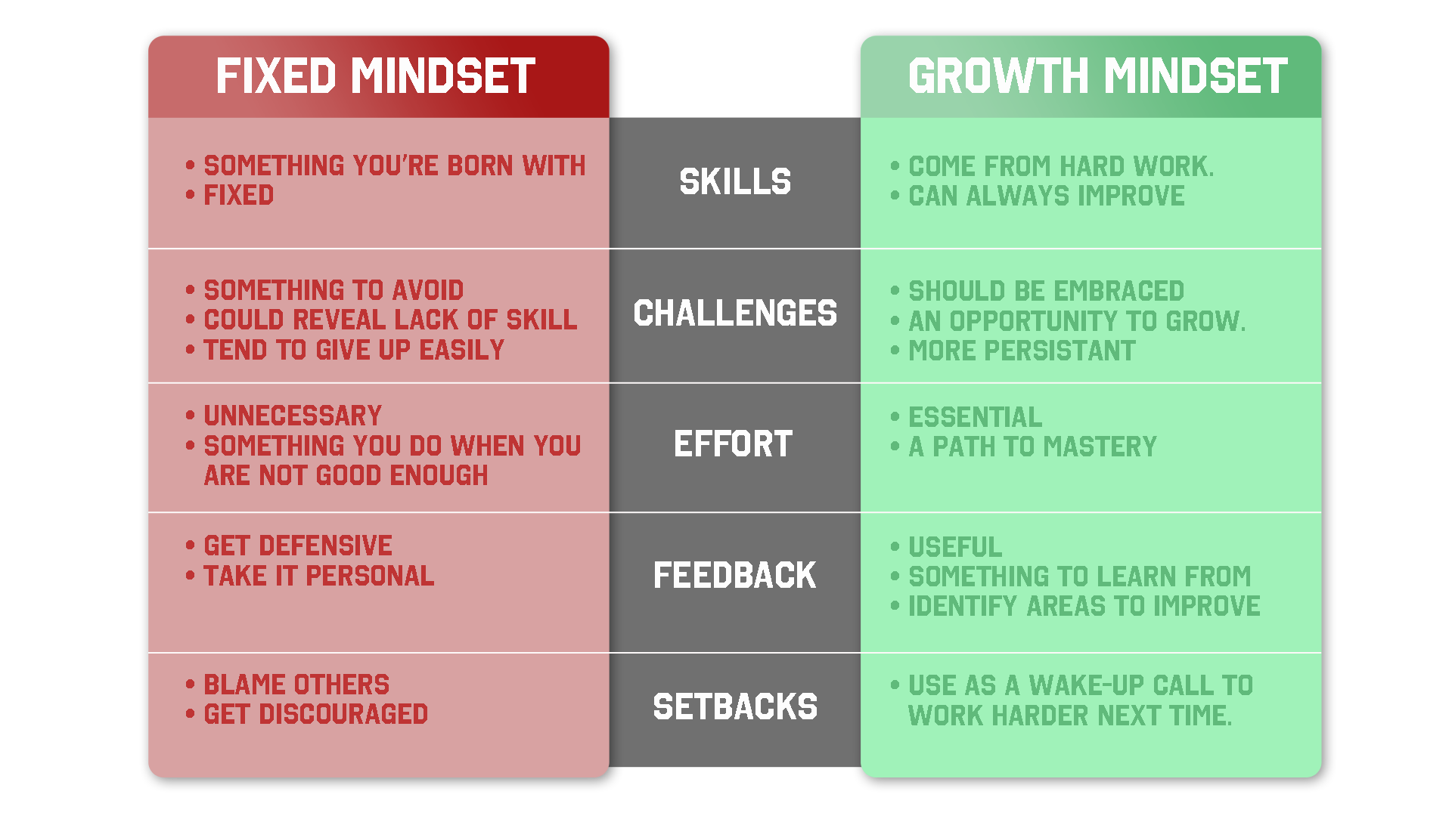

Slide 8
Growth Mindset Misconceptions:
It is not just having a positive outlook
We are not either fixed or growth
Not just praising effort
Not a bunch of affirmations

Slide 9
A Personal Growth Mindset Story

Slide 10
Growth Mindset for Students

Slide 11
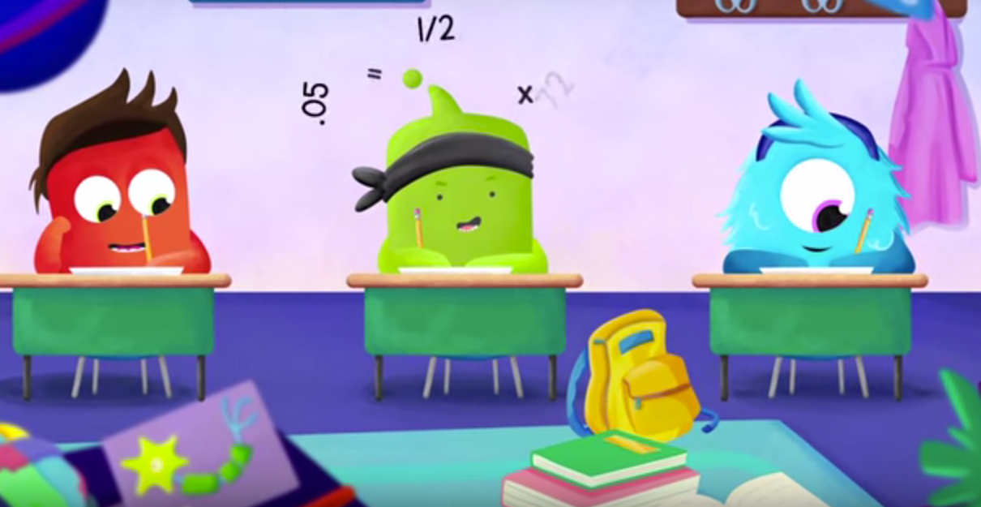
Class Dojo
https://www.youtube.com/watch?v=2zrtHt3bBmQ

Slide 12
Words Make Worlds
INSTEAD OF... | TRY THINKING...
I’m not good at this.
What am I missing?
I give up.
I’ll use a different strategy
This is too hard.
This may take some time.
I made a mistake
Mistakes help me learn
I’ll never be that smart
I’ll figure it out somehow

Slide 13
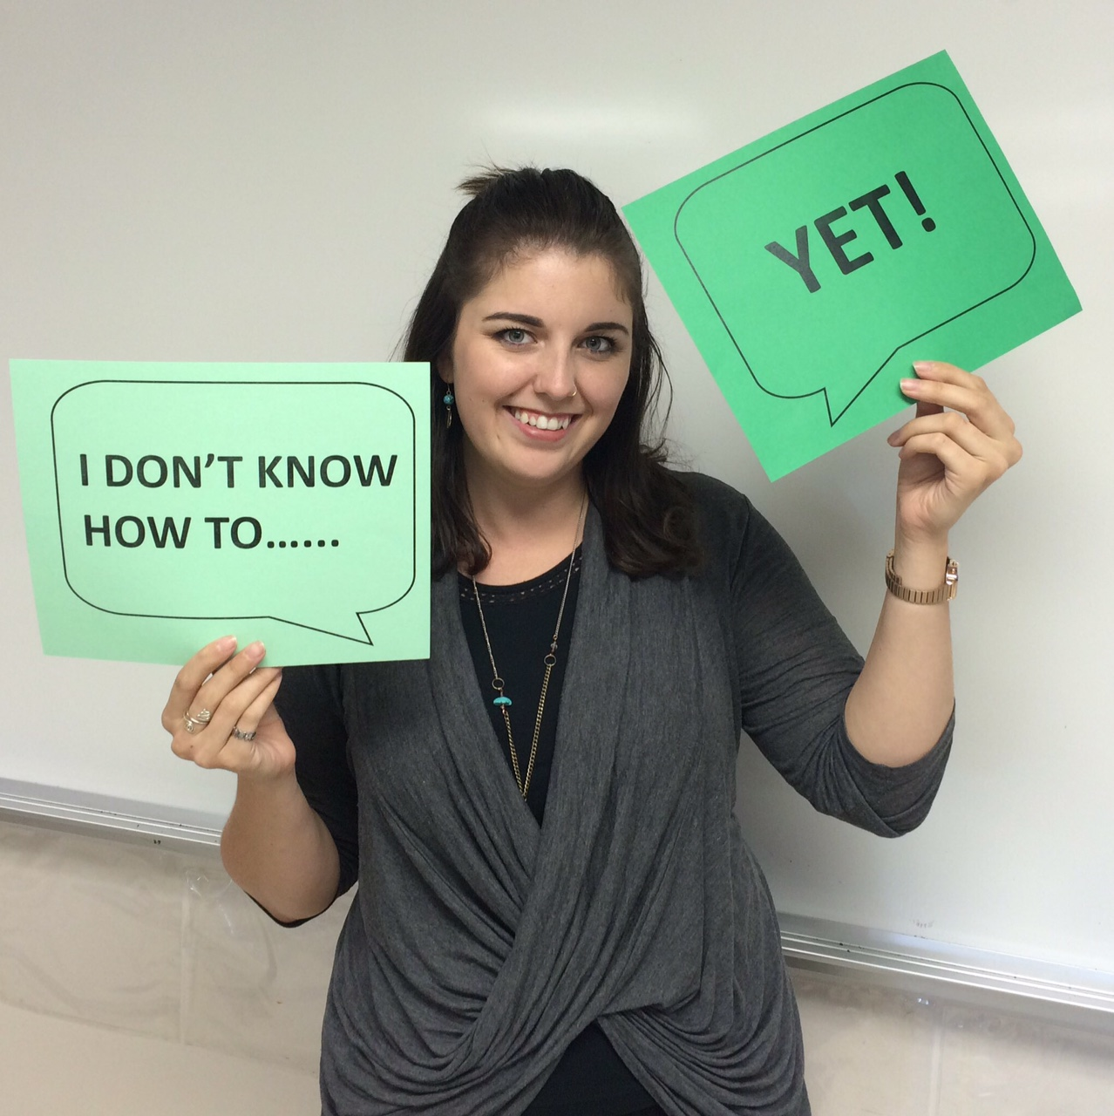
YET!

Slide 15
Story Time

Slide 17
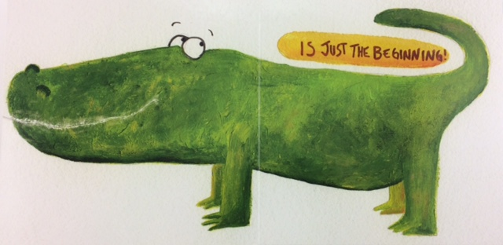

Slide 18
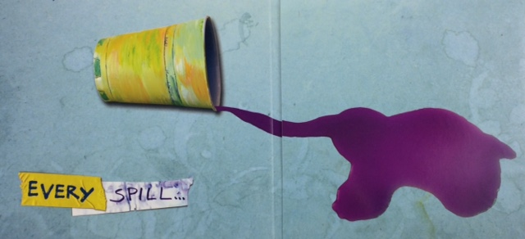

Slide 19
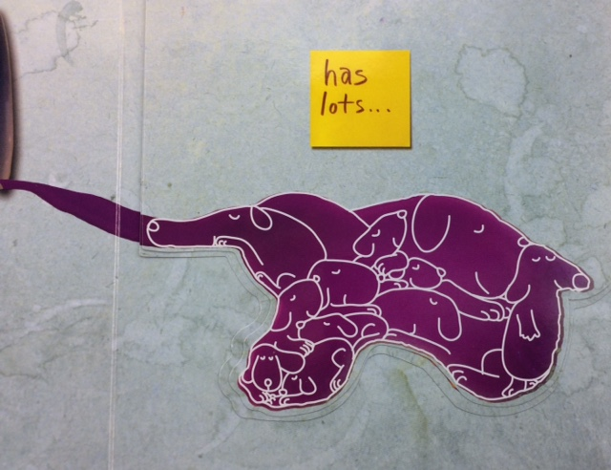

Slide 20
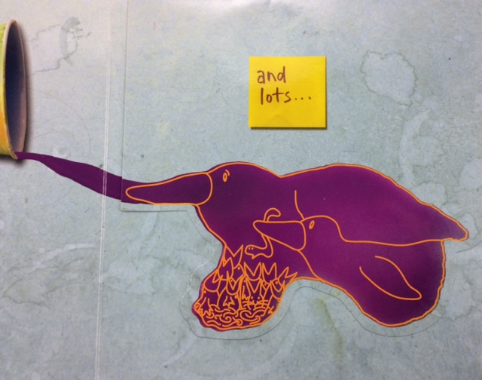

Slide 21
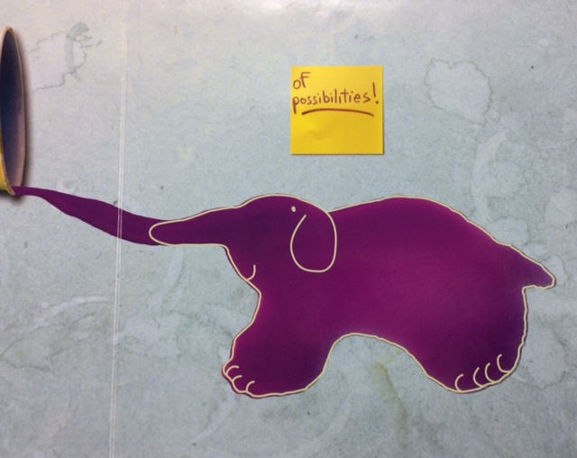

Slide 22
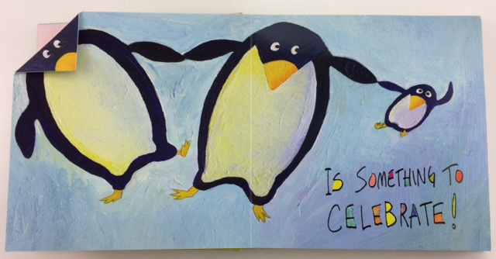

Slide 23
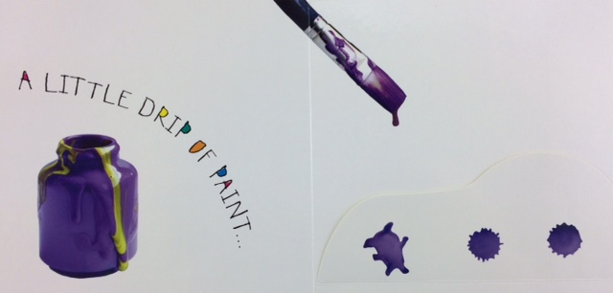

Slide 24
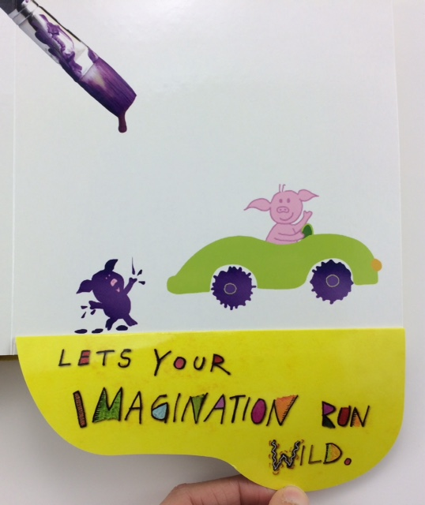

Slide 26
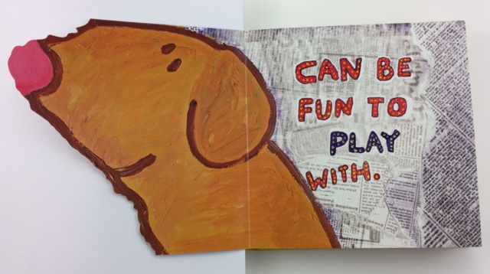

Slide 27
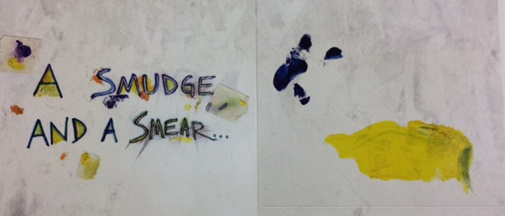

Slide 28
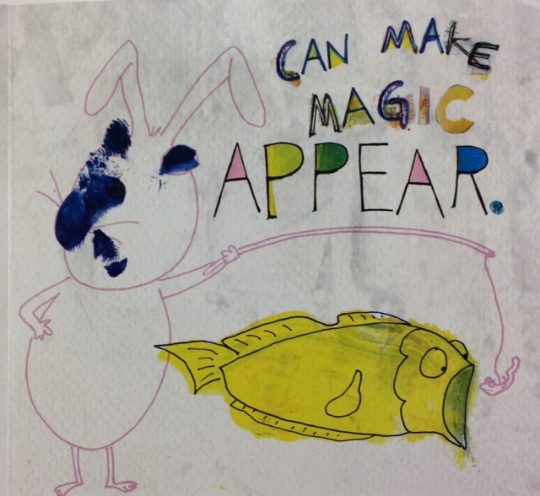

Slide 30
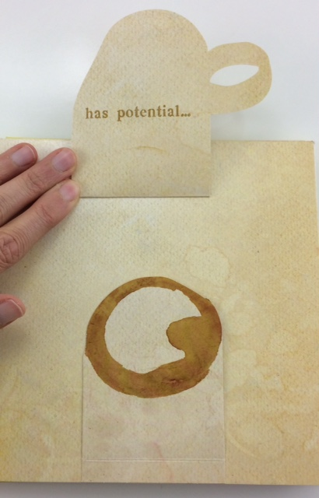

Slide 31
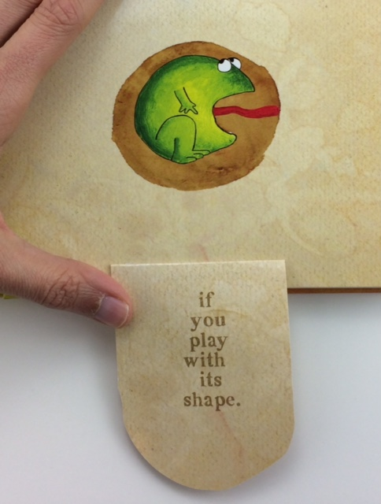

Slide 32
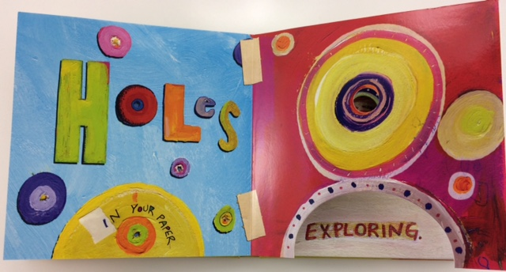

Slide 33
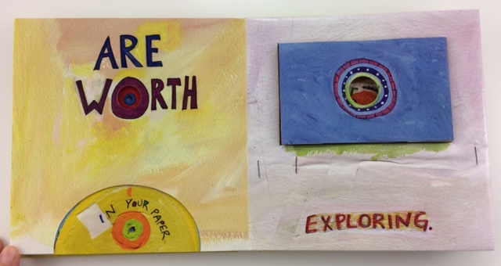

Slide 34
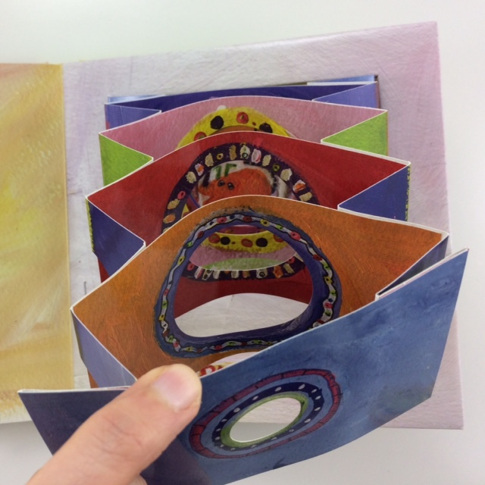

Slide 35
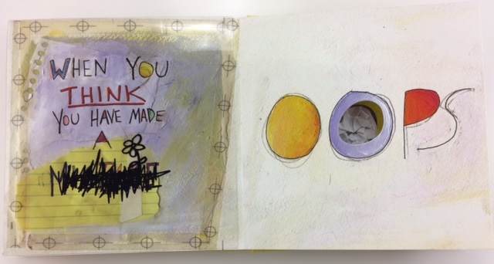

Slide 36
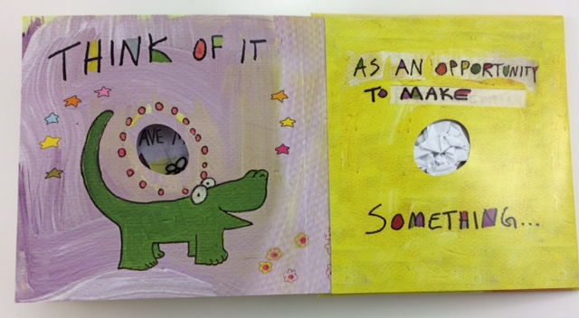

Slide 37
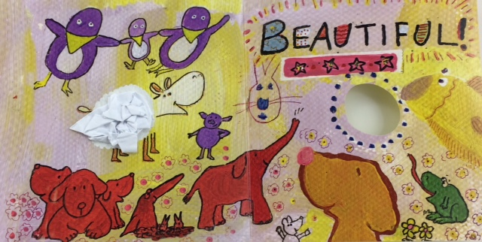

Slide 38
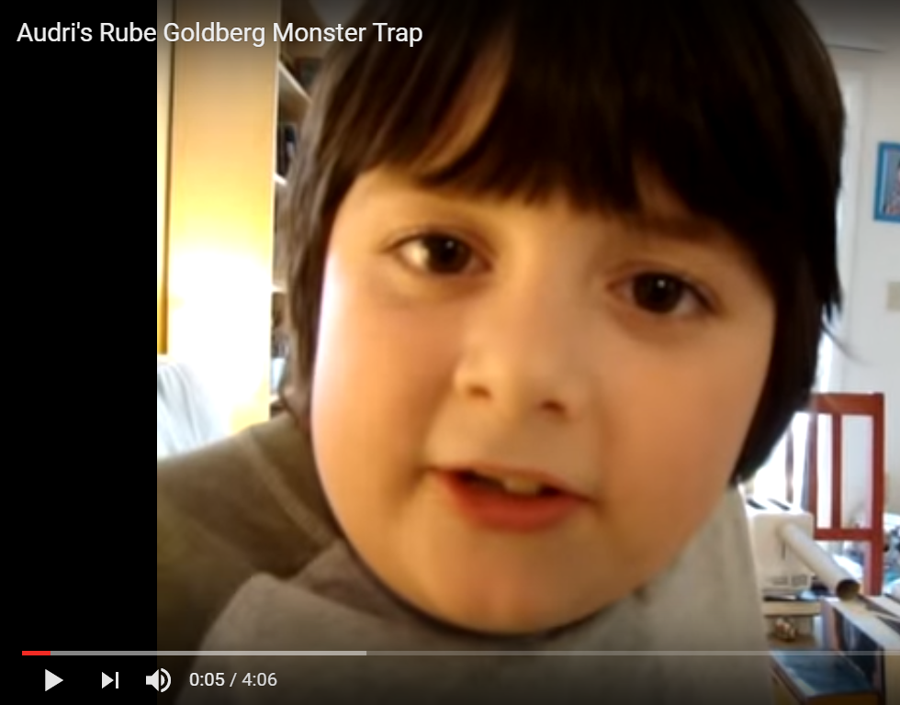
Growth Mindset
https://www.youtube.com/watch?v=0uDDEEHDf1Y
Notes:
https://www.youtube.com/watch?v=0uDDEEHDf1Y

Slide 39
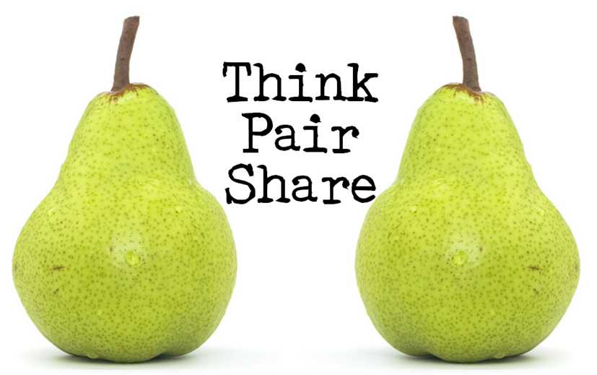

Slide 40
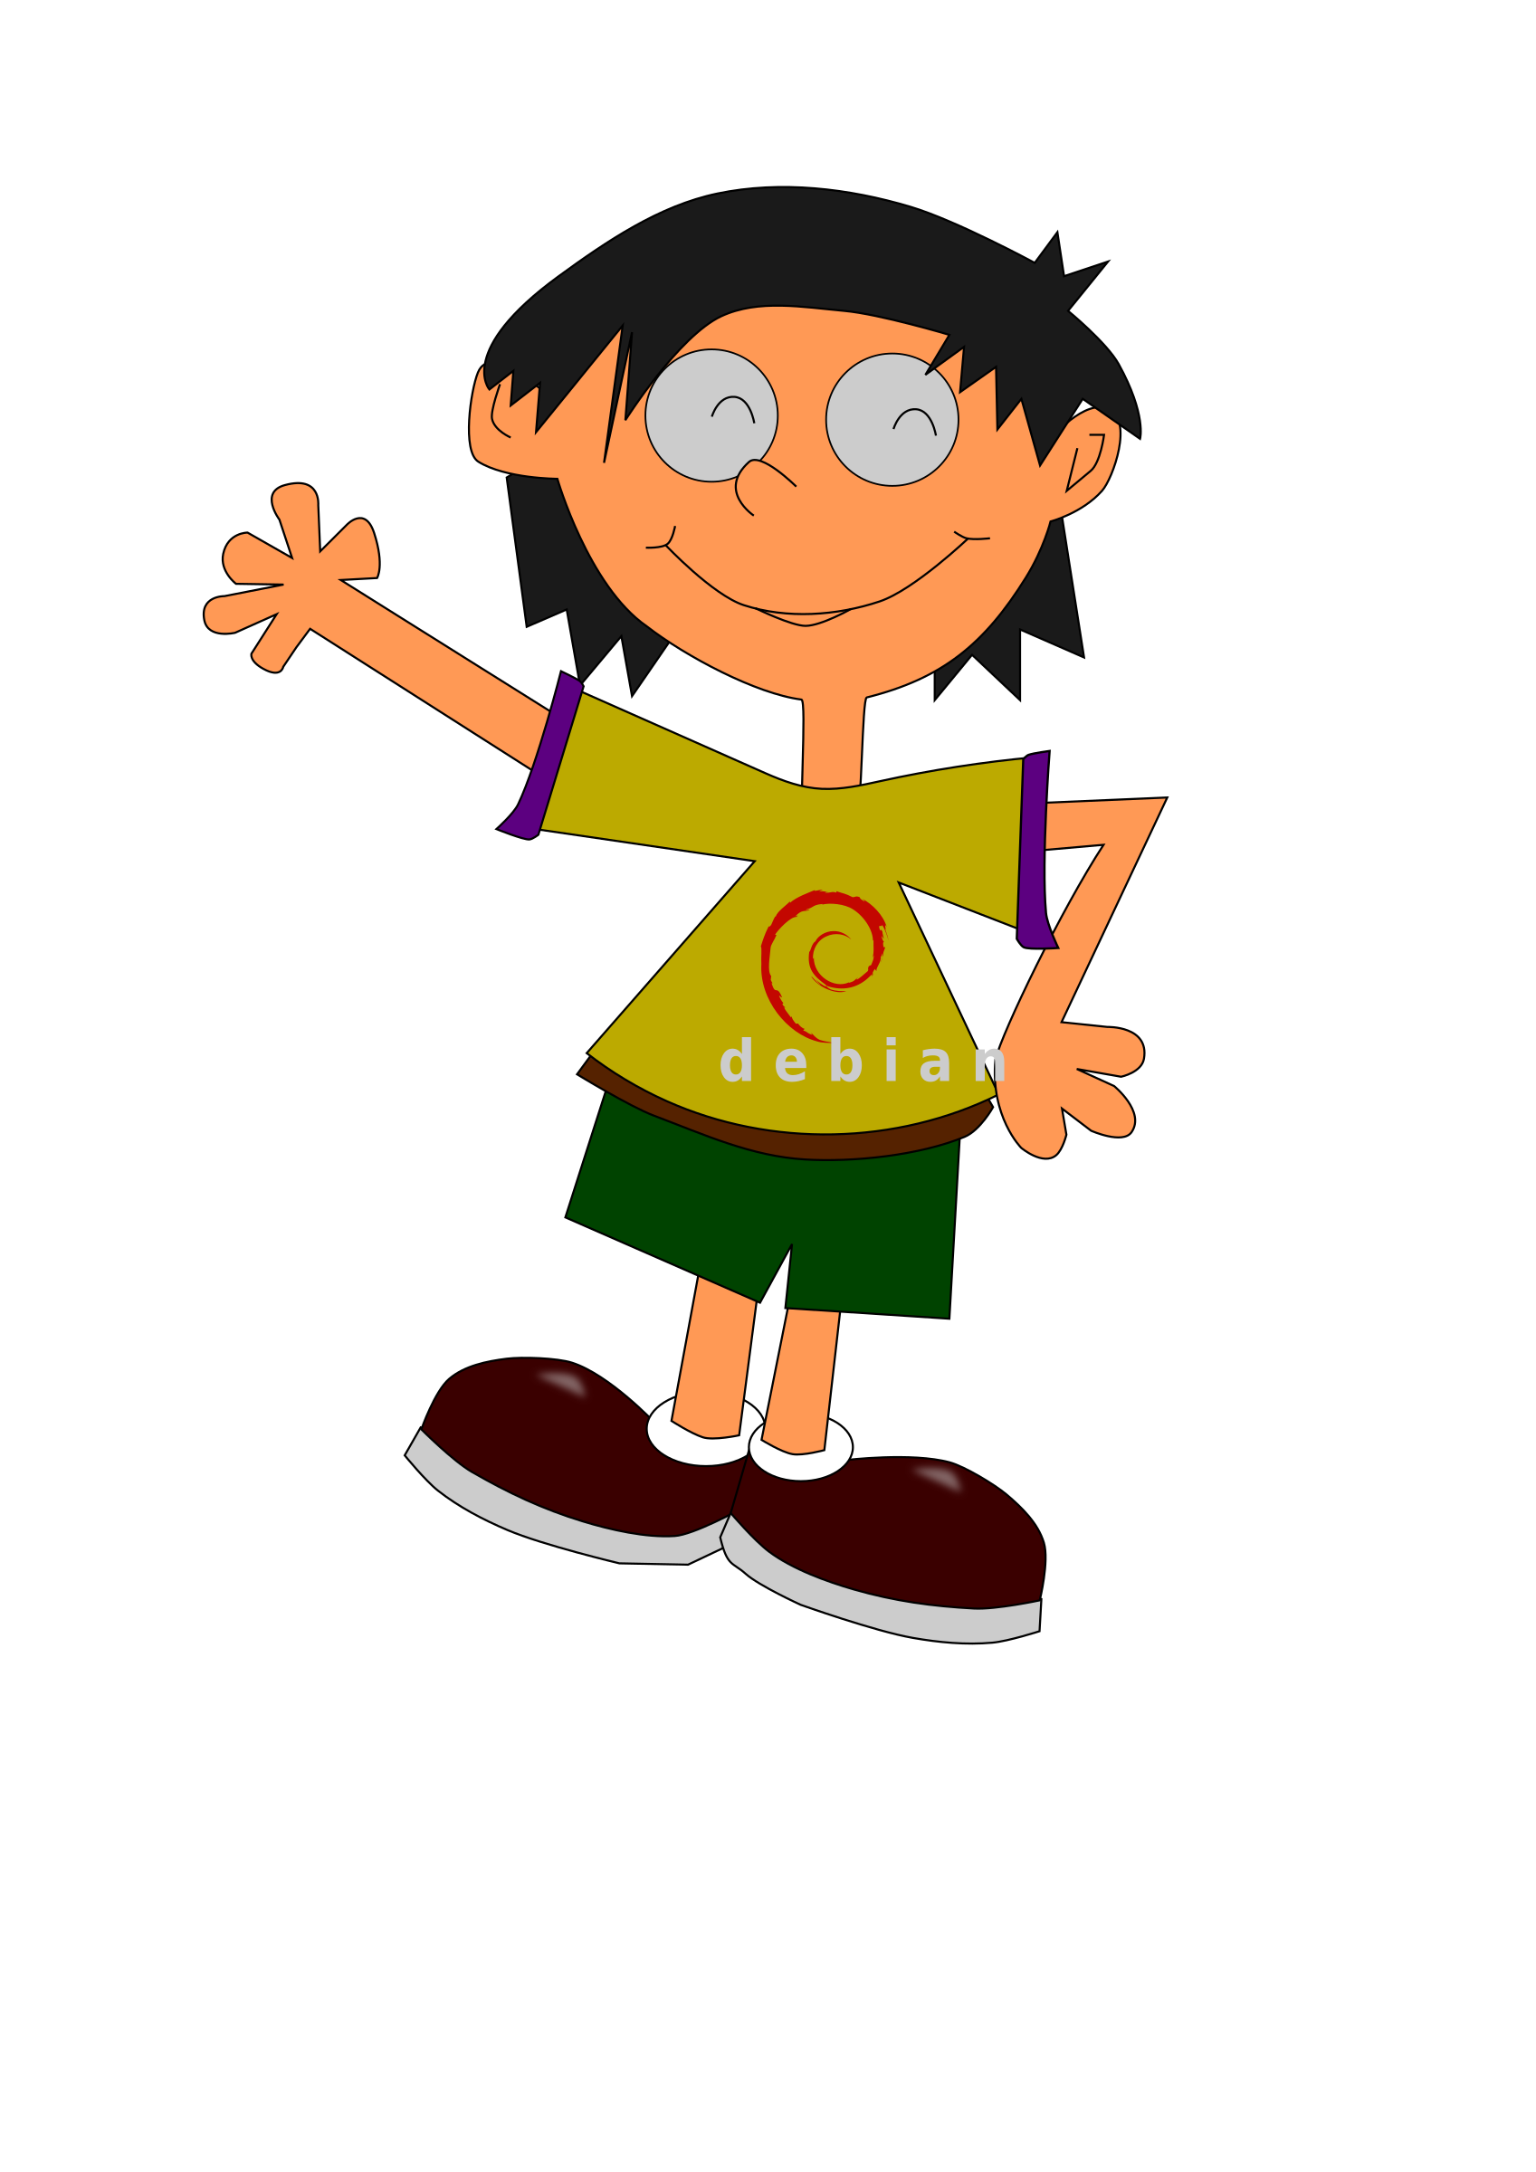
Growth Mindset and Inclusion
Notes:
Think of a child who wonder how you are going to connect and help grow...a wonder child.

Slide 41
Wonder Child

Slide 42
Presume Competence
https://www.youtube.com/watch?v=WKImLzqe6mQ

Slide 43
Words Make Worlds

Slide 44
INSTEAD OF THINKING…
(FIXED MINDSET)
TRY THINKING…
(GROWTH MINDSET)
HE IS NOT READY FOR SCHOOL.
HOW CAN WE GET SCHOOL READY FOR THIS CHILD?
WE DON’T HAVE ENOUGH RESOURCES.
WHAT CAN I DO WITH THE RESOURCES I HAVE?
SHE NEEDS TO BE PULLED OUT TO A SEPARATE SETTING.
HOW CAN I MAKE SURE EVERY CHILD HAS A SENSE OF BELONGING?
I NEED MORE EDUCATION ASSISTANT TIME.
WHAT CAN THIS CHILD DO INDEPENDENTLY?
WE HAVE TRIED THAT STRATEGY BEFORE.
DID ANY PART OF IT WORK?
I WASN’T TRAINED FOR THIS.
WHERE CAN I LEARN MORE?

Slide 45
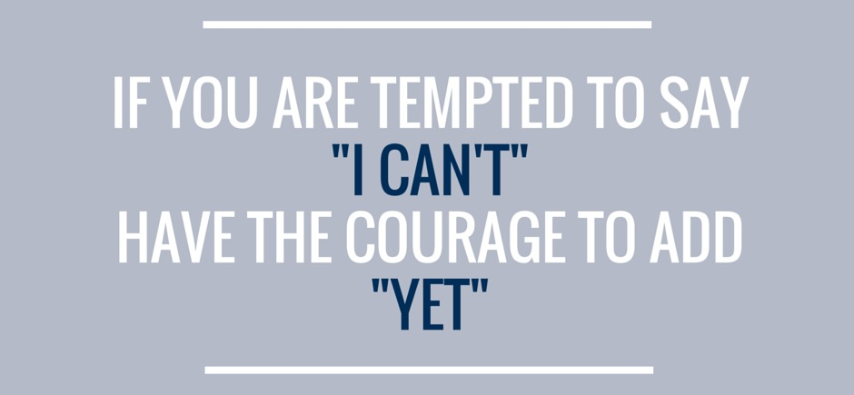
Yet...
Notes:
Resources for Adults and Growth Mindset
http://knowledge.senndelaney.com/docs/thought_papers/pdf/stanford_agilitystudy_hart.pdf

Slide 46
Growth Mindset & Inclusion
Notes:
V Expect to be wrong. Be stress and behaviour detectives. Be prepared to try a new hypothesis and keep trying.

Slide 47
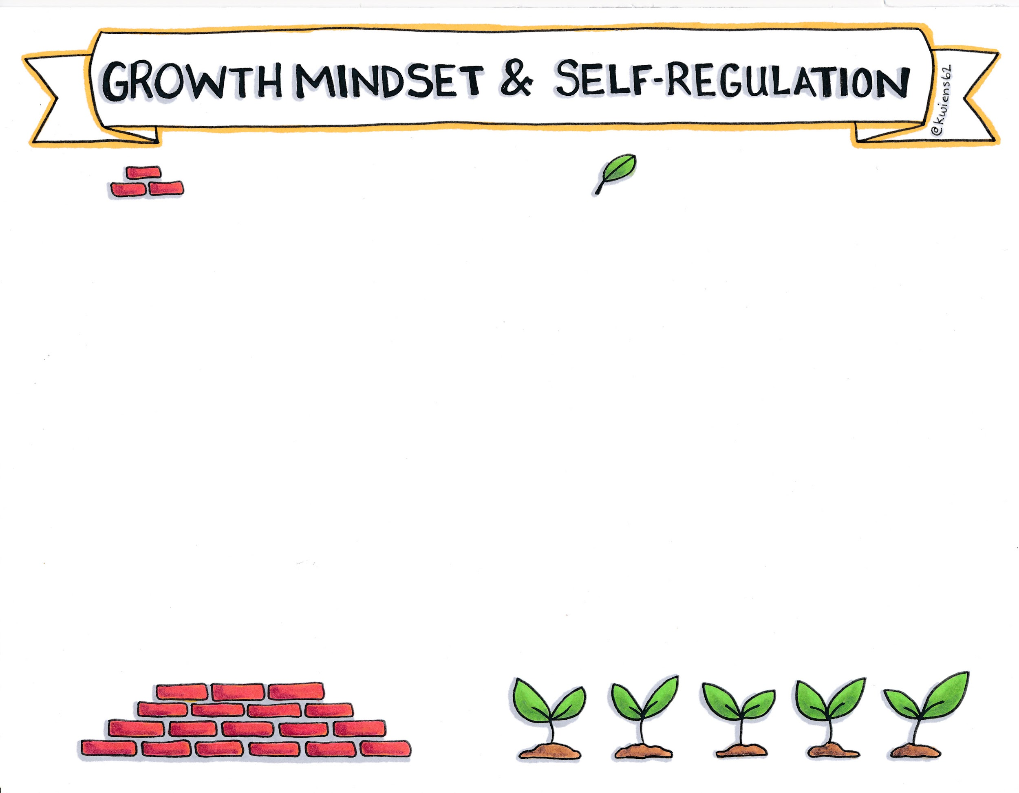
INSTEAD OF THINKING...
TRY THINKING...
HE NEEDS TO LEARN SOME SELF-CONTROL
HE NEEDS HELP WITH SELF-REGULATION
SHE KEEPS GIVING ME A HARD TIME
SHE IS HAVING A HARD TIME.
HOW CAN I HELP?
MY CLASSROOM WORKS FINE FOR ALL THE OTHER STUDENTS.
EVERY STUDENT IS UNIQUE.
WHAT CHANGES CAN I CONSIDER TO SUPPORT THIS STUDENT?
HIS BEHAVIOUR COMES OUT OF THE BLUE.
LET’S LOOK DEEPER FOR PATTERNS AND SETTING EVENTS.
NOTHING WORKS FOR THIS CHILD.
WHAT ELSE CAN I TRY?
SHE JUST NEEDS TO CALM DOWN.
DOES SHE EVEN KNOW WHAT CALM FEELS LIKE?
HE WON’T EVER LEARN SELF-REGULATION
HOW CAN I HELP HIM LEARN SELF-REGULATION?

Slide 48
Wonder Child

Slide 49
Danny’s Story
Notes:
Inclusion = trying new plans, starting fresh, having hope
Risk taking increases

Slide 50
Book Recommendations

Slide 52
Growth Mindset and Self-Compassion

Slide 53
Growth Mindset
starts with ourselves.
Self-regulation
starts with ourselves.

Slide 54
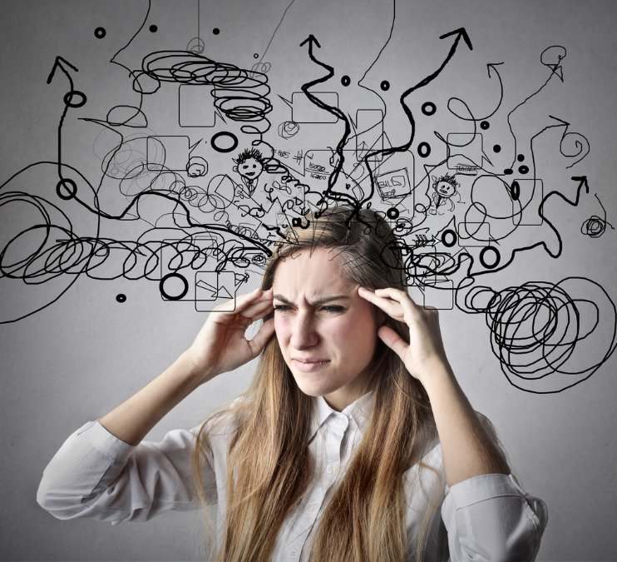
Teeny Weeny Meanie Committee
Notes:
I can’t run story

Slide 55
My Journey

Slide 57
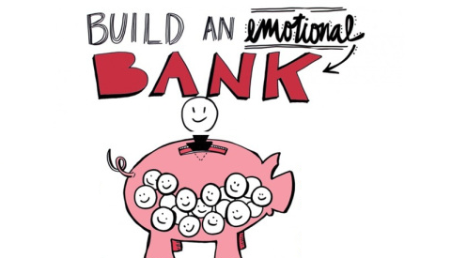
Danny’s Story

Slide 58
Recommended Resources

Slide 60
And take small steps

Slide 61
Danny’s Story

Slide 62
Thank You!

Slide 63
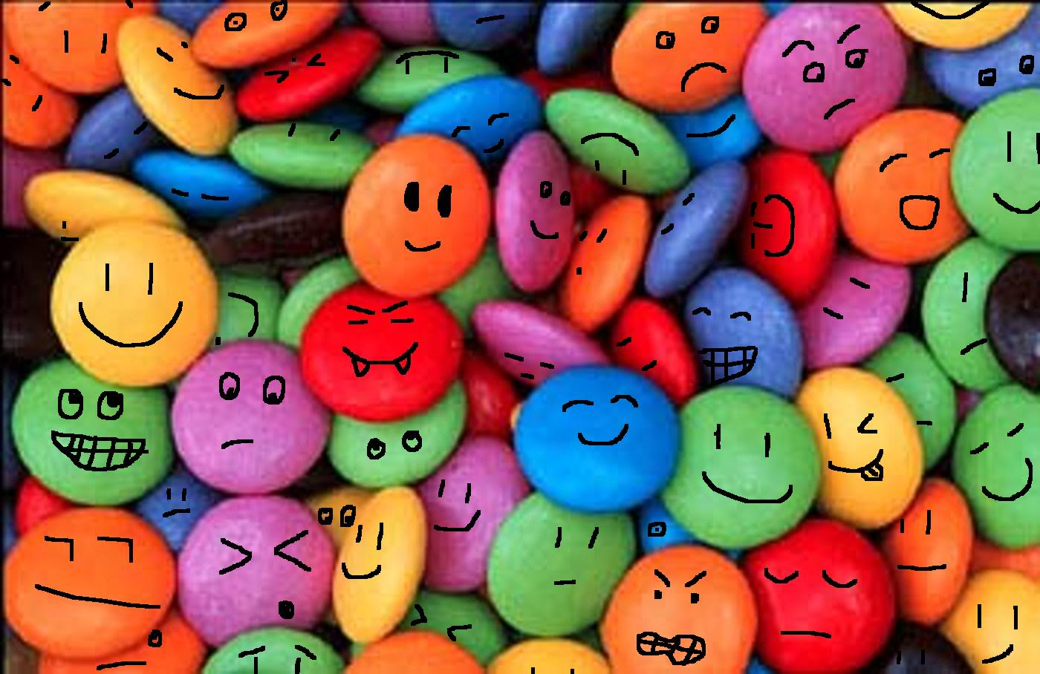
Smartie Game

Slide 65
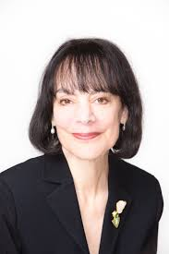
Growth Mindset
https://www.youtube.com/watch?v=NWv1VdDeoRY

